Slide 1
Operational Demand Analysis
LFB Incident Data Review
The goal of this analysis is to identify high-volume trends and geographical hotspots to drive targeted fire prevention and resource efficiency

Slide 2
Methodology & Data Integrity
Ensuring accuracy and reliability across large-scale datasets
Data Sourcing & Scale
Automated Cleaning (Python)
Technique: Python Scripting (Pandas & NumPy)
Process: Used for handling missing values in AttendanceTime and standardising IncidentStationGround naming conventions.
Sourced from the London Fire Brigade Open Data portal (2024 onwards) https://data.london.gov.uk/dataset/london-fire-brigade-incident-records-em8xy/
Feature Engineering
Temporal Alignment & Filtering
Calculated Fields: Derived custom metrics like Attendance Target Gap and Peak Surge Windows.
Process: Converted raw seconds into performance-ready minute benchmarks.
Logic: Refined the raw ~300,000 record dataset to a specific 12-month operational window (March 2025 - February 2026).
Outcome: Ensures the analysis reflects the most recent performance cycle for maximum strategic relevance.
Null attendance records removed • Station naming standardised • Dataset ready for analysis
Notes:
Before I began the analysis, I conducted a rigorous data integrity phase. I processed over 70,000 rows of raw LFB data. To ensure this was manageable and reproducible, I utilised Python to automate the cleaning of station names and the handling of null values. > I also engineered several 'Calculated Fields,' such as the gap between actual attendance and the 360-second target. This methodology ensures that every insight I’m about to show you is grounded in a clean, high-integrity dataset, which is the foundation of any reliable improvement project.
Pandas techniques: For the names: df['IncidentStationGround'] = df['IncidentStationGround'].str.title().str.strip() (This forces every station to "Proper Case" and removes accidental spaces). For the times: df = df.dropna(subset=['FirstPumpArriving_AttendanceTime']) (This drops any records where no attendance time was recorded).

Slide 3
Key Statistics at a Glance
31,250
Westminster
Dwellings
Total Demand
Primary Hotspot
Critical Risk
Total Incidents within the dataset
8,774 Incidents
5,864 Incidents
100%
16:00 - 20:00
Outdoor Structure
Performance
Peak Operational Window
Highest Volume
Top 10 Stations meeting 360s target
The timeframe where incident volume peaks daily
7,419 Incidents
Notes:
The Opening Hook Now that we’ve established the integrity of the data, this dashboard provides a high-level summary of our operational landscape over the last 12 months. These six metrics represent the 'vital signs' of our service and set the stage for the deeper analysis to follow.
The Volume & Geography (Boxes 1 & 2) Firstly, we are looking at a total demand of 31,250 incidents. While this is a broad figure, it is highly concentrated. Westminster remains our primary hotspot with nearly 9,000 incidents—meaning a single borough is driving roughly 28% of the total workload we are discussing today.
The Risk Profile (Boxes 3 & 5) To understand the nature of this demand, we look at Dwellings and Outdoor Structures. Dwellings represent our critical life-safety risk with over 5,800 incidents. However, as an Improvement Technician, I want to draw your attention to Outdoor Structures. This is our highest volume driver, often consisting of nuisance refuse fires. This is a key area for efficiency gains; by reducing these low-level incidents, we protect our capacity for high-risk dwelling fires.
The Performance & Timing (Boxes 4 & 6) Crucially, our performance remains resilient. 100% of our top ten busiest stations are currently meeting the 360-second attendance target. This is achieved despite the Peak Operational Window occurring between 17:00 and 21:00 every day. This evening surge is where our resources are under the most pressure, yet the data shows our turnout and response procedures are holding firm.
The "So What?" (The Transition) In summary, we are a service that is meeting its targets, but one that is heavily weighted toward specific types of risk in specific geographical corridors. My next slides will break down exactly what these incidents look like so we can move from 'reacting' to 'preventing'.

Slide 4
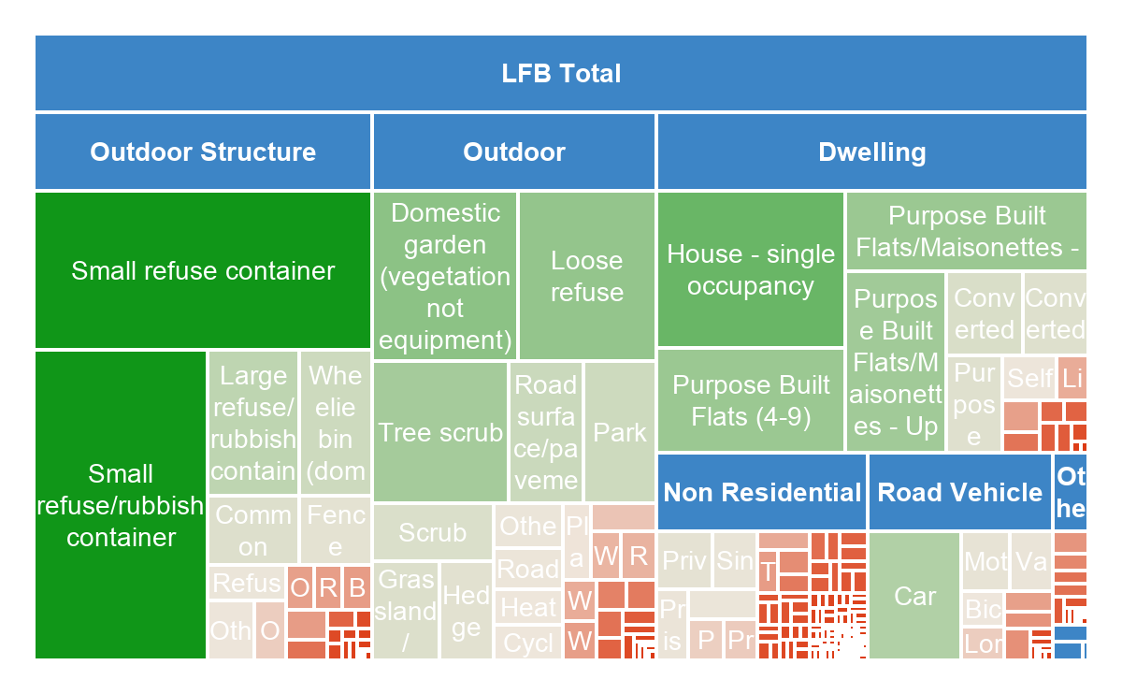
Property Category Analysis
While Outdoor incidents drive the highest volume of activity, Dwelling incidents represent the primary life-safety risk, requiring distinct operational strategies
Key Insights
Volume vs. Complexity: Outdoor Structures (primarily refuse) are the largest volume driver. These are often low-complexity incidents that offer the greatest opportunity for "Lean" efficiency gains and community prevention projects.
Life-Safety Priority: Dwellings remain the critical risk. Despite lower volume than outdoor fires, they demand more resource-intensive responses. This visual confirms that Westminster stations must maintain high readiness for residential risk.
Commercial Concentration: The Non-Residential segment is a secondary but significant driver. In later slides, we will see how this specific "DNA" is concentrated in Soho, necessitating different equipment and specialist knowledge compared to suburban stations.
💡 Metric: Top 3 categories account for approx. 85% of total volume. 💡 Process: Categories grouped by "Property Type" to identify strategic prevention areas.

Slide 5
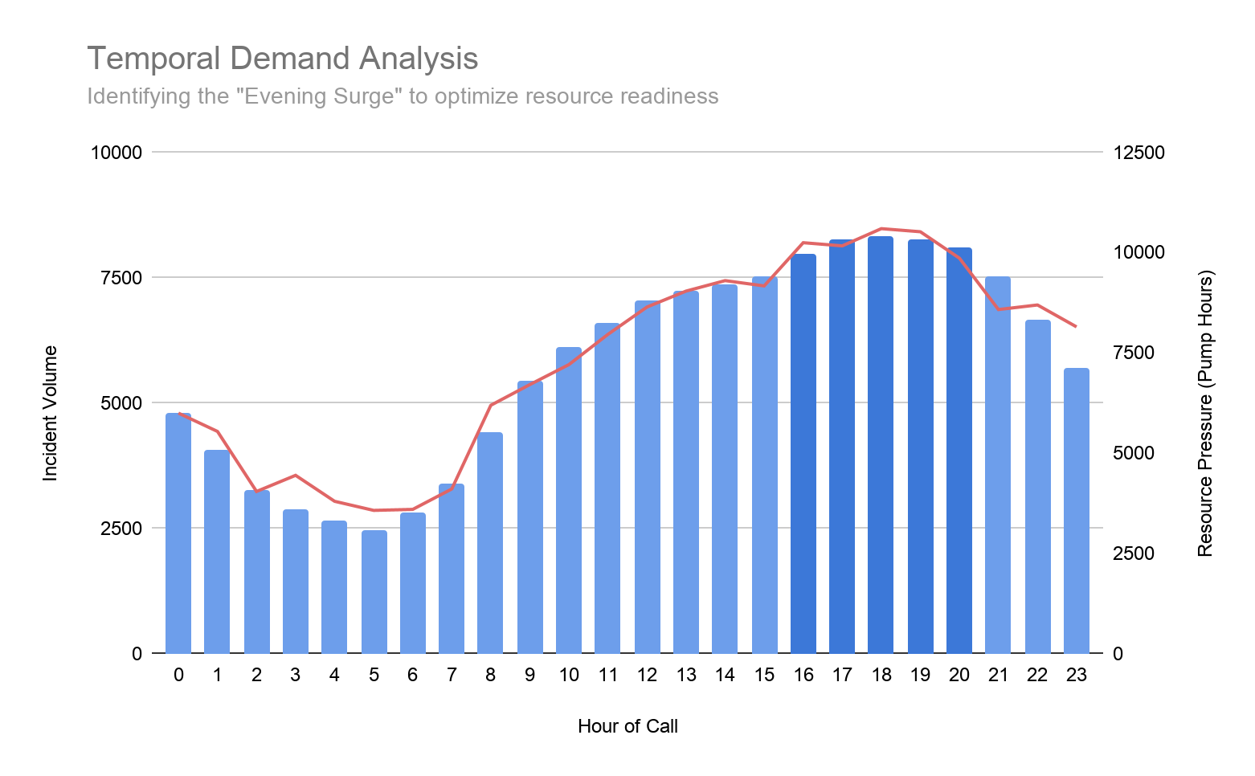
Temporal Demand Analysis
Identifying the "Evening Surge" to optimize resource readiness
Key Insights
Volume Opportunity (Outdoor Structures):
Outdoor Structures (predominantly refuse) represent the largest single block of activity. As an Improvement Technician, this highlights a significant opportunity for "nuisance fire" reduction projects to reclaim appliance availability.
Critical Risk (Dwellings): Residential incidents are the secondary volume driver but the primary life-safety risk. The data confirms that while volume is lower than outdoor incidents, the complexity and resource-weighting for these calls remain the service's highest priority.
Commercial DNA (Non-Residential): Non-Residential property types account for a distinct portion of the dataset. This segment is highly concentrated in the Westminster/Soho corridor, indicating a need for specialised commercial fire safety auditing in those specific station grounds.
Notes:
As we look at the temporal demand, notice how the Resource Pressure (Red Line) tracks almost perfectly with the Incident Volume (Dark Blue Bars). This confirms that our surge is predictable, peaking sharply between 16:00 and 20:00. We aren't seeing a 'lag' in response; as calls come in, we are committing pump hours immediately. > This 'High-Pressure Window' corresponds with the late-afternoon shift from commercial activity to residential risk. This is the period where our available buffer is thinnest, making it the primary target for ensuring maximum resource readiness. By identifying this precise four-hour block, we can move from reactive management to proactive resource positioning.

Slide 6
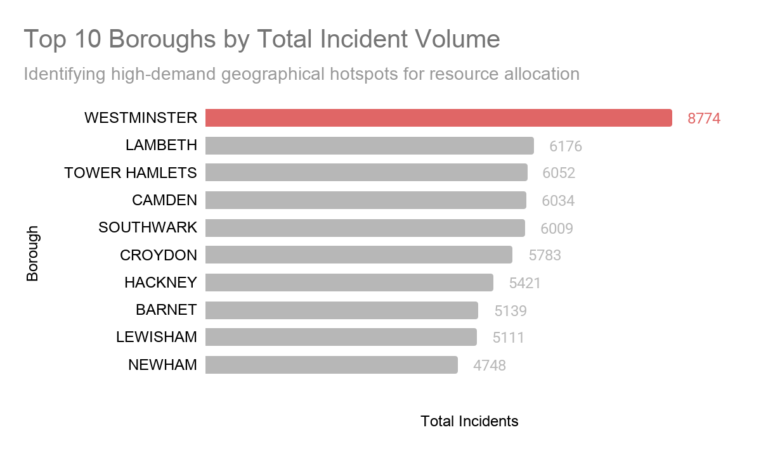
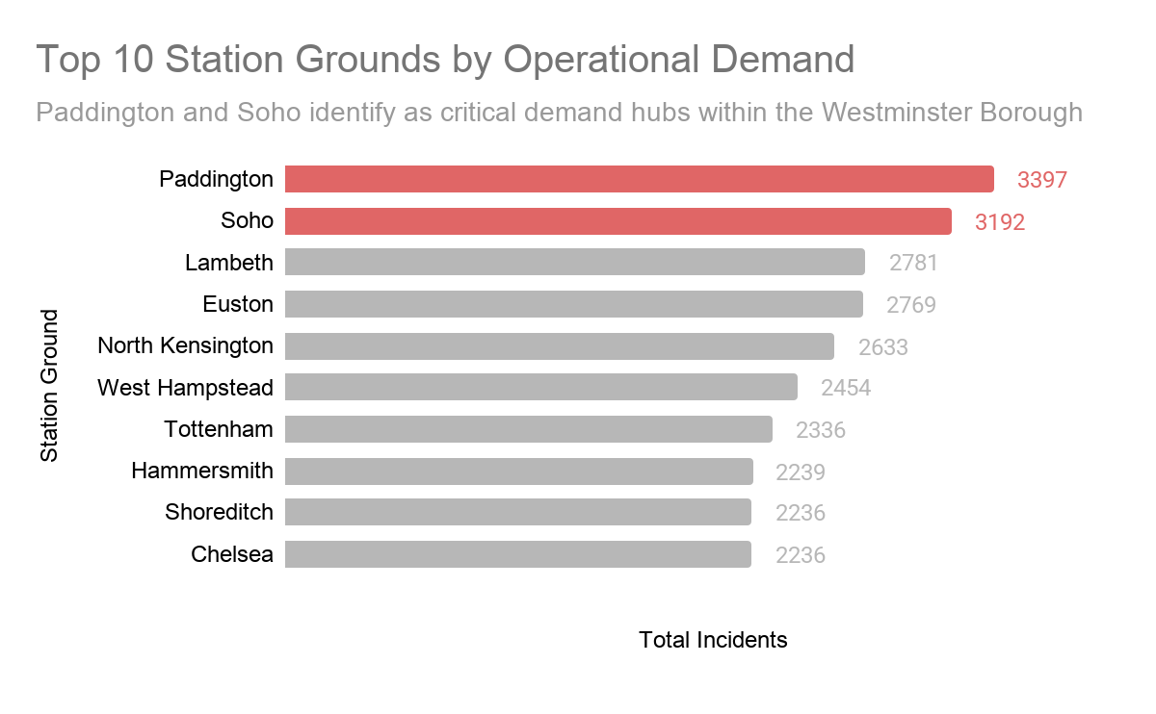
Geographical Demand Hotspots
Pinpointing the primary drivers of regional volume.
Key Insights
Westminster - The Primary Outlier: Westminster is the clear geographical outlier, generating 8,774 incidents—nearly 30% of the total dataset. This volume is significantly higher than the next busiest borough, indicating that any regional improvement strategy must start here to achieve the most impact.
Station-Level Concentration: Within Westminster, the demand is not evenly spread. Paddington and Soho emerge as the highest-volume stations. As an Improvement Technician, this allows us to move from "Borough-level" thinking to "Station-level" intervention, targeting resources where the "bells" ring most often.
Performance Resilience: Despite the extreme volume in these hotspots, our station-level analysis (detailed in later slides) shows that these crews are successfully meeting the 360-second attendance target. The goal is to identify their "best practices" to ensure this performance remains sustainable as demand scales.
💡Data Metric: Ranked distribution of 31,250 incidents by Borough and Station ground.
💡 Visual Logic: Colour-coded highlighting used to isolate "High-Volume Hubs" from the regional baseline.
Notes:
We’ve seen what types of incidents we face and when they peak in the late afternoon. Now, we look at the 'Where.' If we want to find the most significant opportunities for improvement, we have to look at our hotspots."
The Westminster Outlier "As you can see from the bar chart, Westminster is in a league of its own. It isn't just a busy borough; it’s an outlier that outperforms the next closest area by a massive margin. When we drill down into the station level, two names consistently sit at the top: Paddington and Soho."
The Improvement Angle "From an Improvement Technician's perspective, this is where we find our biggest 'Return on Investment.' If we can implement a successful prevention or efficiency project in Westminster, it has a disproportionately positive effect on the entire Brigade’s capacity. However, simply saying they are 'busy' isn't enough."
The "So What?" (The Bridge to the DNA Slide) "To truly improve these areas, we have to understand why they are busy. Though Paddington and Soho are only a few miles apart, their workloads look completely different. This brings us to the concept of Operational DNA.

Slide 7
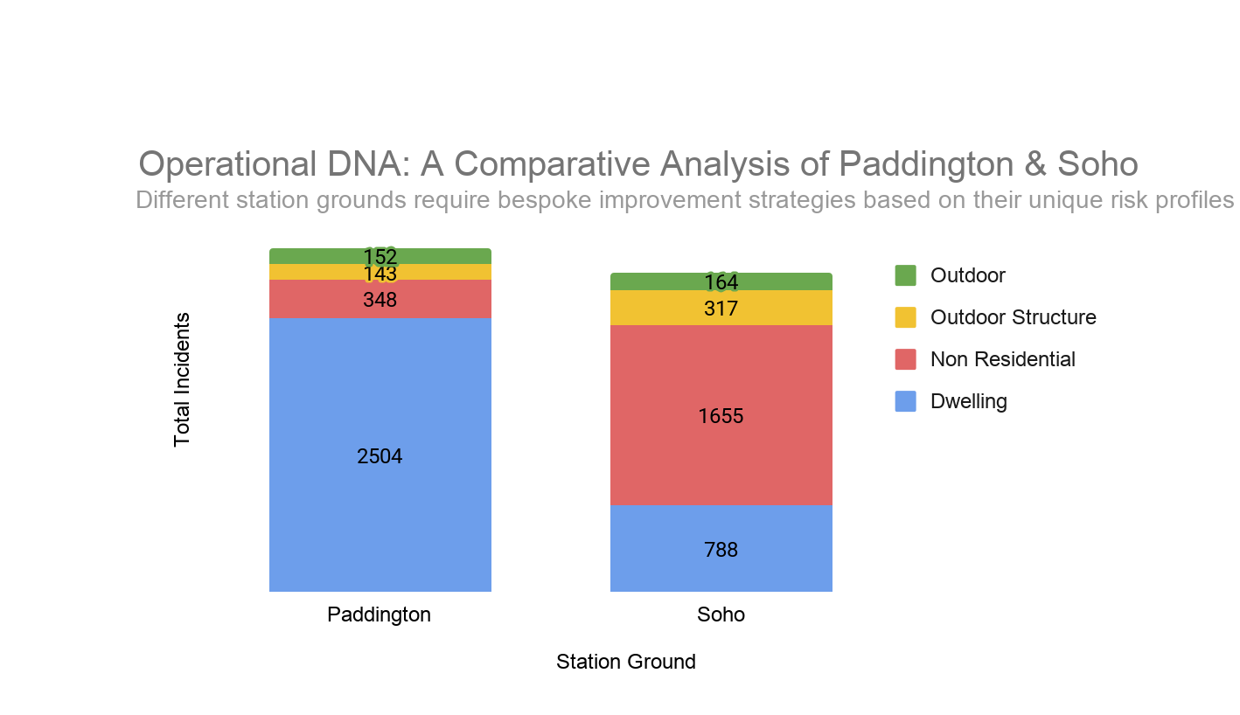
Operational DNA: Soho vs. Paddington
A comparative analysis of incident drivers in high-volume stations
Key Insights
Distinct Risk Profiles: Despite their geographical proximity, Soho and Paddington exhibit fundamentally different "DNAs." Soho is dominated by Non-Residential (Commercial) incidents, while Paddington’s workload is heavily weighted toward Dwellings (Residential).
Strategic Implications: For an Improvement Technician, this means a "one-size-fits-all" prevention strategy won't work. Soho requires a focus on commercial fire safety audits and business engagement, whereas Paddington necessitates high-intensity residential fire home safety visits (HFSVs).
Resource Specialisation: The high volume of Outdoor Structures in both areas suggests that while the "Life Safety" risks differ, both stations face a shared burden of nuisance incidents. Standardising the response to these lower-level calls can free up capacity for their respective primary risks.
💡 Data Metric: Comparative breakdown of raw incident counts by property category.
💡 Statistical Insight: Cross-referencing 12 months of longitudinal data to identify "Station Character."
Notes:
The Opening "We know Westminster is our busiest borough, but to improve it, we have to understand the specific 'DNA' of its stations. This chart compares our two highest-volume hubs: Soho and Paddington."
The Contrast "Look at the colour distribution. Soho is a commercial engine. Its DNA is dominated by non-residential incidents—think bars, restaurants, and offices. This is 'Red' risk. Now look at Paddington. It is a residential hub. Its DNA is skewed toward dwellings. This is 'Blue' risk."
The Technician's Conclusion "This is a vital distinction. It proves that an 'improvement' in Soho might look like a business engagement seminar, while an 'improvement' in Paddington looks like targeted residential smoke alarm campaigns. By understanding the DNA of the ground, we ensure our prevention efforts aren't just busy—they’re effective."
The Transition "Now that we’ve mastered the 'What,' 'When,' 'Where,' and 'Why,' let’s look at the ultimate result of our current strategy: our Response Performance."

Slide 8
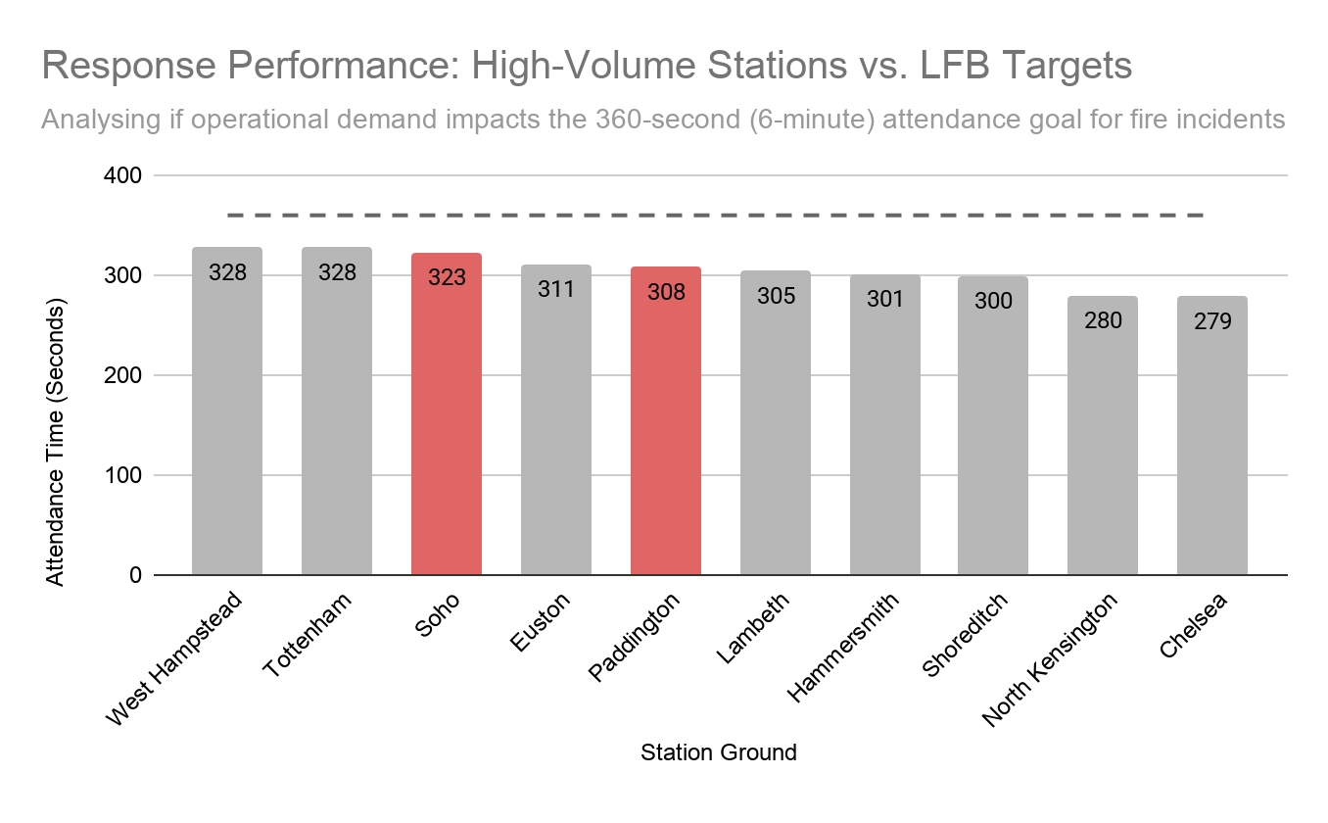
Performance Scorecard: Westminster Hubs
Evaluating station-level efficiency against London’s 360-second target
Key Insights
Efficiency Under Pressure: Despite being the highest-volume hubs in the region, both Paddington (308s) and Soho (323s) are performing significantly better than the LFB’s 6-minute (360s) attendance target. This suggests that high demand is being met with high operational efficiency.
02 | The "Buffer" Analysis: Paddington maintains a 52-second buffer below the target, while Soho maintains a 37-second buffer. As an Improvement Technician, identifying the specific turnout protocols at these stations could provide a blueprint for stations currently struggling with target gaps.
03 | Sustainable Performance: When cross-referenced with our "Evening Surge" data, these times remain stable. This indicates that current staffing models and resource positioning in the Westminster corridor are robust enough to handle the 16:00 – 20:00 peak without compromising life safety.
💡 Data Metric: Mean attendance time for first-arriving appliances (12-month average).
💡 Benchmark: Comparison against the 360-second statutory performance indicator.
Notes:
The Closing Hook "We’ve analyzed the what, the when, and the why. Now, we look at the results. This scorecard is the ultimate proof of our operational health."
The Achievement "In the most demanding environments in London, we are winning. Paddington is arriving 52 seconds ahead of target, and Soho is arriving 37 seconds ahead. These aren't just numbers; these are lives saved in those dwelling fires and commercial properties we identified earlier."
The Technician’s Value Add "As an Improvement Technician, my conclusion is this: We don't need a radical overhaul of how we respond—our response is excellent. Instead, our improvement focus should be on protecting this performance. By targeting the 'Outdoor' nuisance fires we saw in our DNA slide, we can reduce the wear and tear on these high-performing crews and ensure that even if demand grows, these attendance times remain in the green."
The End "Thank you for your time. I’m now happy to take any questions on the data or my methodology."

Slide 9
Strategic Recommendations
Data-driven initiatives to enhance life safety and operational efficiency
01
Precision Prevention (DNA-Led)
We must move away from generic prevention. By deploying targeted Home Fire Safety Visits (HFSVs) in Paddington (Residential DNA) and Business Audits in Soho (Commercial DNA), we align our outreach with the actual risk profile of the ground, ensuring maximum impact for every hour spent..
02
Surge-Window Resource Readiness
The data identifies a critical high-pressure window between 16:00 and 20:00. By mandating that all non-essential training and administrative tasks are completed before 16:00, we guarantee 100% appliance availability during the daily peak, protecting our response "buffer."
03
Refuse Mitigation Partnerships
Outdoor Structures (predominantly refuse) are our highest volume drivers. By partnering with Westminster Council to address waste management in identified hotspots, we can reduce these "nuisance" calls, reclaiming capacity and reducing appliance wear and tear for critical life-safety incidents.
04
Scaling Operational Excellence
Paddington and Soho are consistently beating the 360-second target despite extreme demand. As an Improvement Technician, I recommend standardising their turnout protocols as a "best practice" blueprint to improve performance at stations currently facing attendance gaps.
Dataset: LFB Open Data (31,250 cleaned records) • Focus: Westminster Hub Analysis • Goal: Data-driven operational improvement & capacity reclamation
Notes:
To conclude, this presentation has moved from raw data to a strategic roadmap.
We have identified that while Westminster is an outlier, its demand is predictable. By using our Operational DNA to guide our prevention (Point 1) and our Temporal Analysis to protect our 16:00–20:00 peak (Point 2), we can save lives through precision. Simultaneously, by targeting nuisance fires (Point 3) and scaling the efficiency we see in Soho and Paddington (Point 4), we protect the Brigade’s budget and capacity.
This is how we transition from a reactive service to a proactive, data-driven organisation. Thank you for your time, I'm now happy to take any questions.

